Slide 1

What do you notice?
What do you wonder?

Slide 2
Mosiacs
Learning Intentions & Success Criteria
I am learning about the artform of Mosiacs
I will be successful when I can create a mosiac.
I will be successful when I can compare and analyze imagery in mosiacs.
Agenda & Materials
Mosiac Video
Mosiac Discussion
Create your own Mosiac
Galley Walk

Slide 3
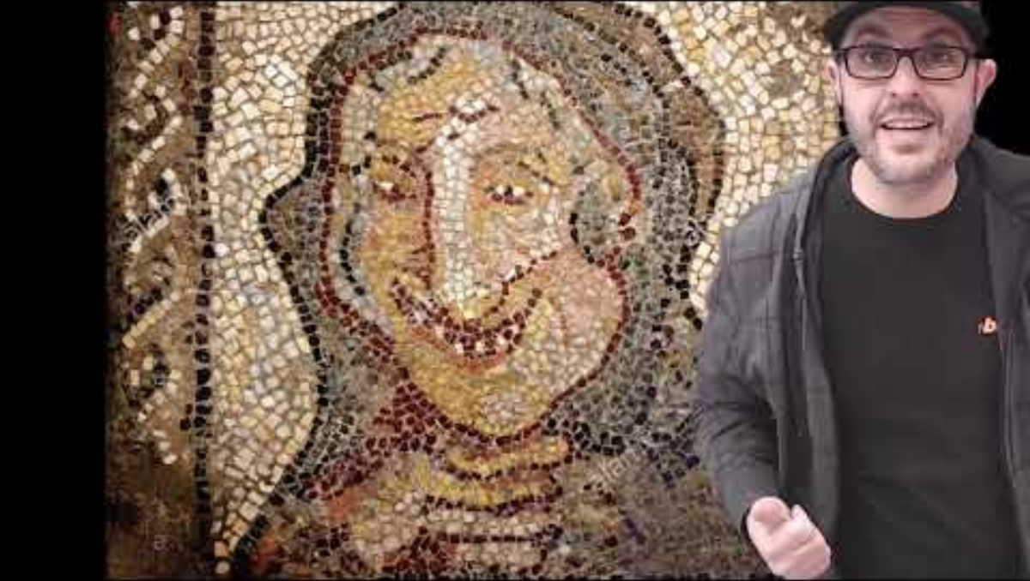

Slide 4
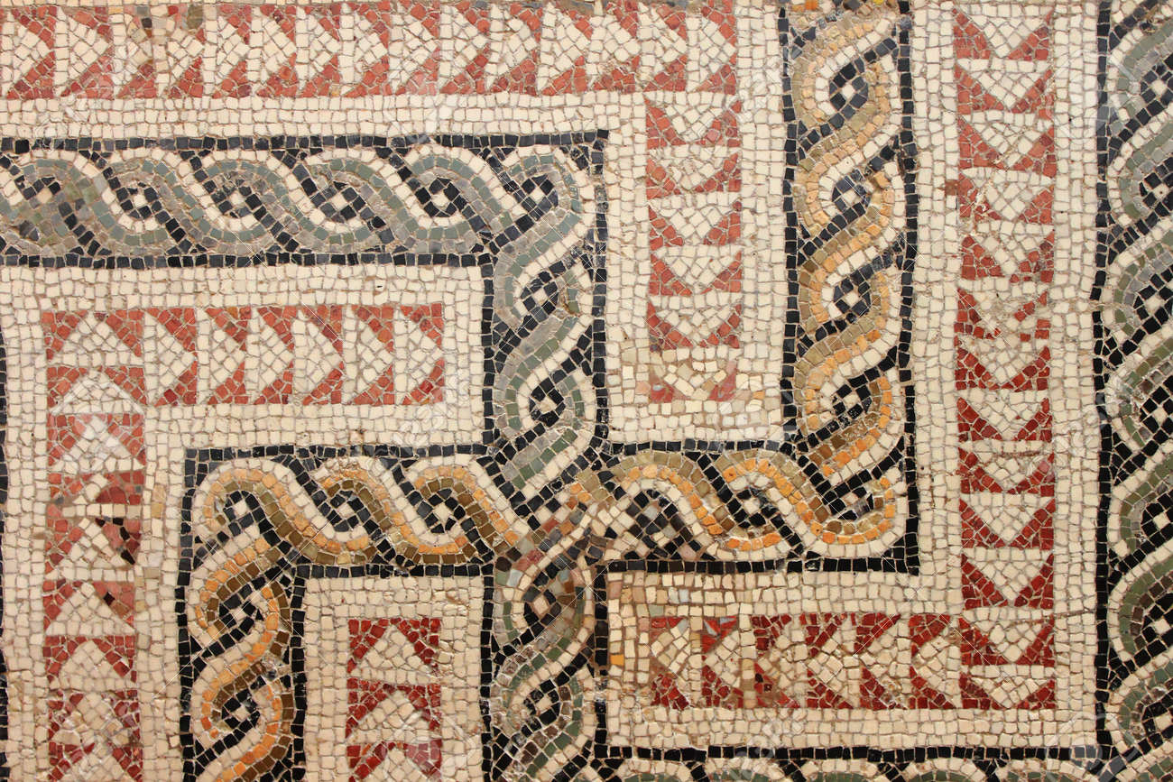
Ancient Roman Mosaic

Slide 5

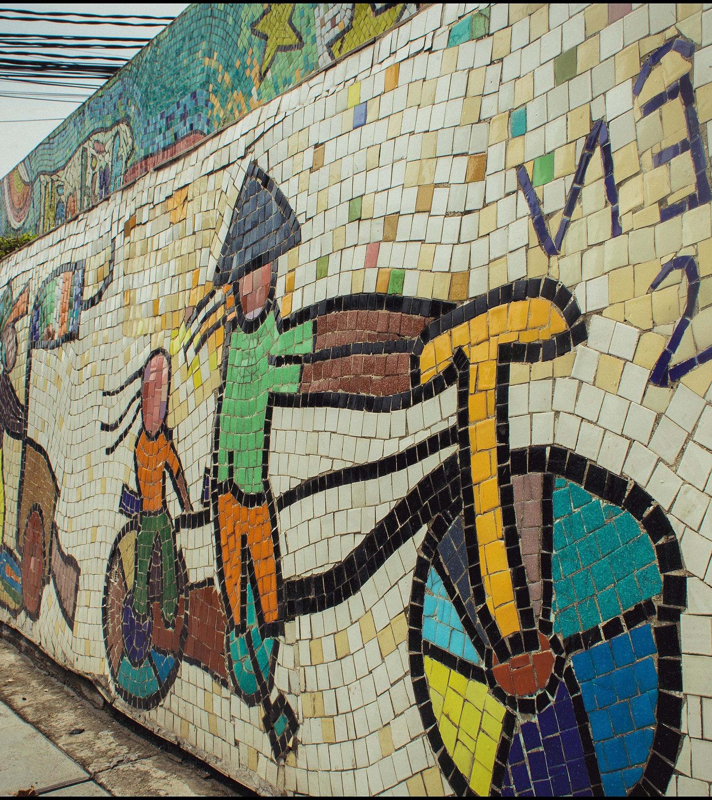
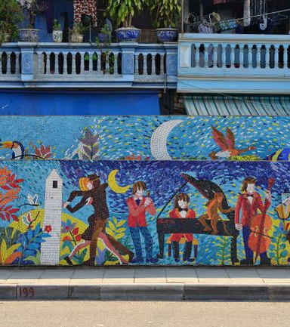
Hanoi Ceramic Mosaic Mural, Vietnam

Slide 6
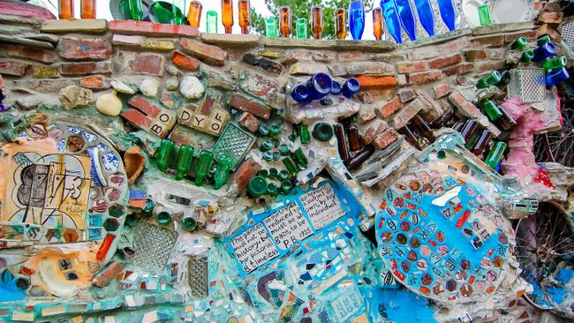
Philadelphia's Magic Gardens

Slide 7
Make your Mosaic
Using your Mosaic planner worksheet, create a 100 piece mosaic
You must use all 100 pieces of paper.
The papers may be cut into other shapes, but they all parts should be used to preserve the color ratios.
The mosaic needs a title.
You may use the Mosaic Organizer, or create a freeform design.
Write a short statement about the inspiration, message, or feelings you wish to convey.

Slide 8
Gallery Walk
Rules
Consider the whole piece before giving feedback.
Level 1 voices (whispers).
Leave feedback on at least 2 pieces.
Put your name on your note.
Feedback Prompts
What do you like about this art?
What feelings does it evoke?
What surprises you?
Do you have any questions?

